Slide 1
Lecture 3
Discrete-time Markov Chains

Slide 2
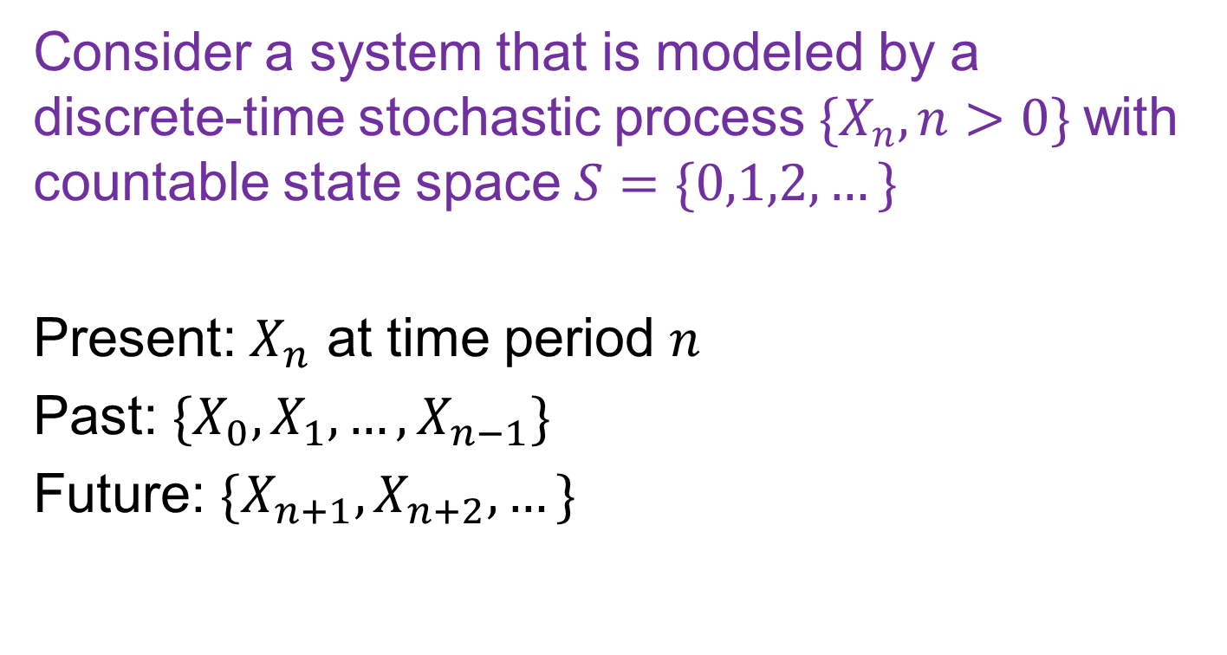
Discrete-time Stochastic Process
Consider a system that is modeled by a discrete-time stochastic process ${\{X}_{n}, n>0\}$with countable state space $S=\{0,1,2,…\}$
Present: $X_{n}$ at time period $n$
Past: ${\{X_{0},X_{1},…,X}_{n−1}\}$
Future: $\{X_{n+1},X_{n+2},…\}$

Slide 3
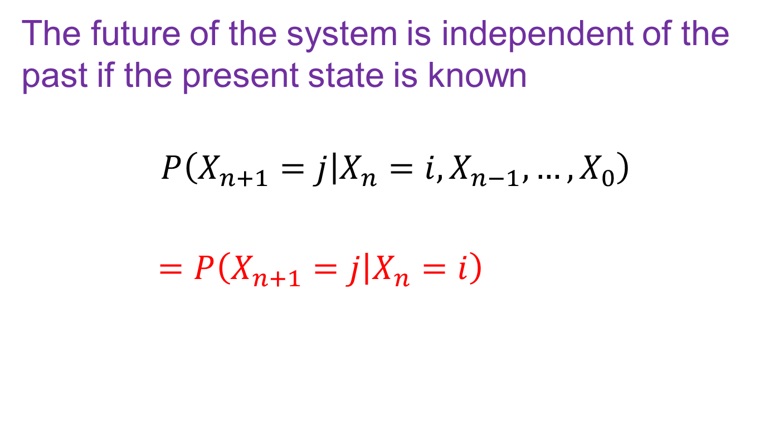
Markov Property
The future of the system is independent of the past if the present state is known
$$P\left(X_{n+1}=j | X_{n}=i, X_{n−1},…, X_{0}\right)$$
$=P\left(X_{n+1}=j | X_{n}=i\right)$

Slide 4
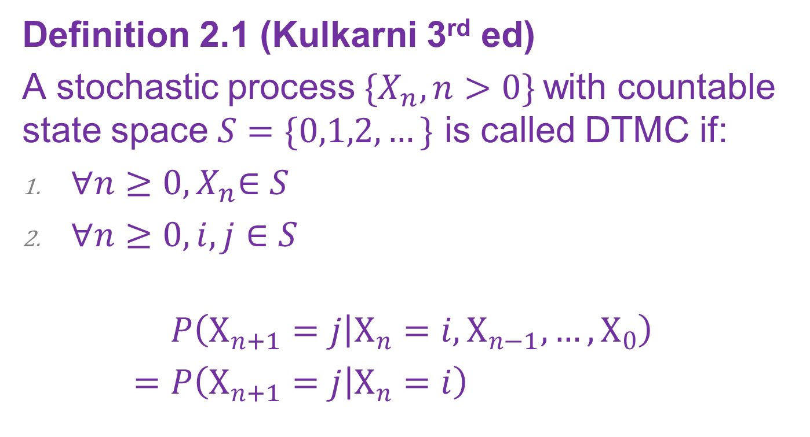
Discrete-time Markov Chain (DTMC)
Definition 2.1 (Kulkarni 3rd ed)
A stochastic process ${\{X}_{n}, n>0\}$with countable state space $S=\{0,1,2,…\}$ is called DTMC if:
${∀n≥0, X}_{n}∈S$
$∀n≥0, i,j∈S$
$$P\left(X_{n+1}=j | X_{n}=i, X_{n−1},…, X_{0}\right)$$
$=P\left(X_{n+1}=j | X_{n}=i\right)$

Slide 5
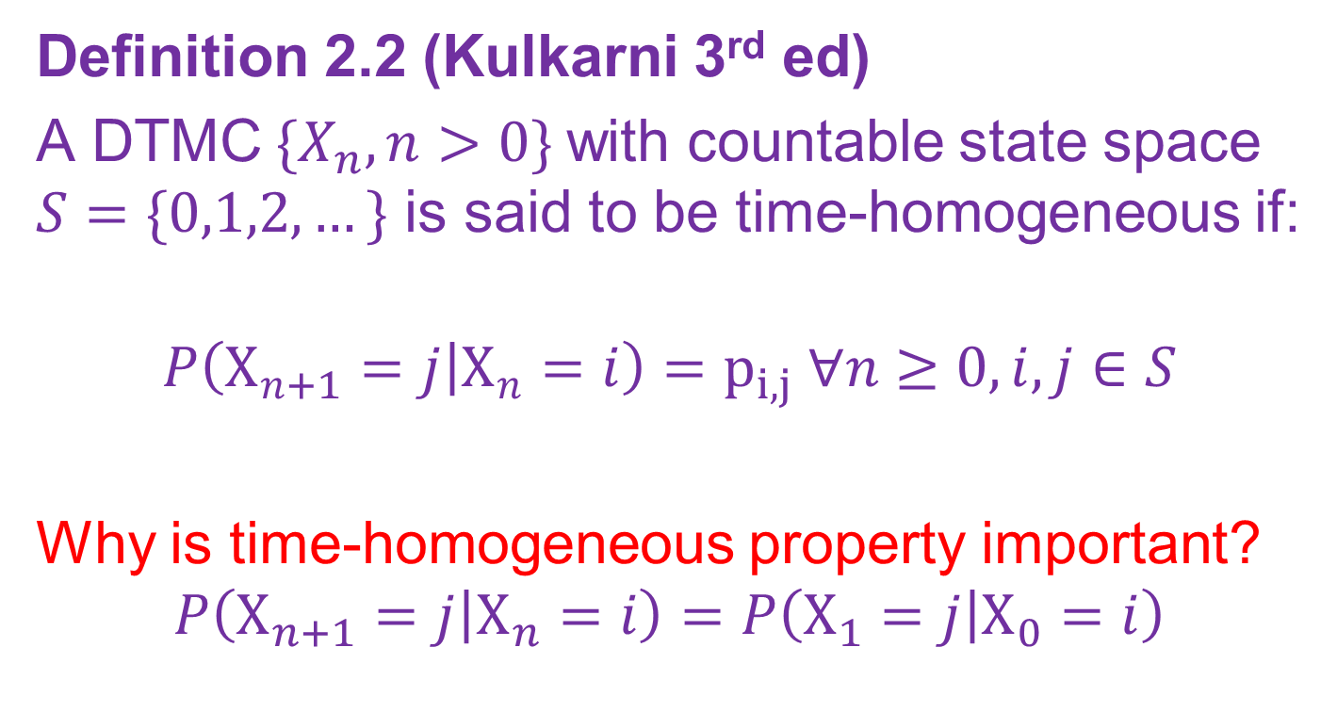
Time Homogeneous DTMC
Definition 2.2 (Kulkarni 3rd ed)
A DTMC${\{X}_{n}, n>0\}$with countable state space $S=\{0,1,2,…\}$ is said to be time-homogeneous if:
$$P\left(X_{n+1}=j | X_{n}=i\right)=p_{i,j} ∀n≥0, i,j∈S$$
Why is time-homogeneous property important?
$$P\left(X_{n+1}=j | X_{n}=i\right)=P\left(X_{1}=j | X_{0}=i\right)$$

Slide 6
Example 1
A production facility produces one item per hour. Each item is defective with probability p, the quality of successive items being independent. Consider the following quality control policy parameterized by two positive integers k and r. In the beginning the policy calls for 100% inspection, the expensive mode of operation. As soon as k consecutive non-defective items are encountered, it switched to economic mode and calls or inspecting each item with the probability 1/r. It reverts back to the 100% inspection mode as soon as an inspected item is found to be defective. The process alternates this way forever.

Slide 7
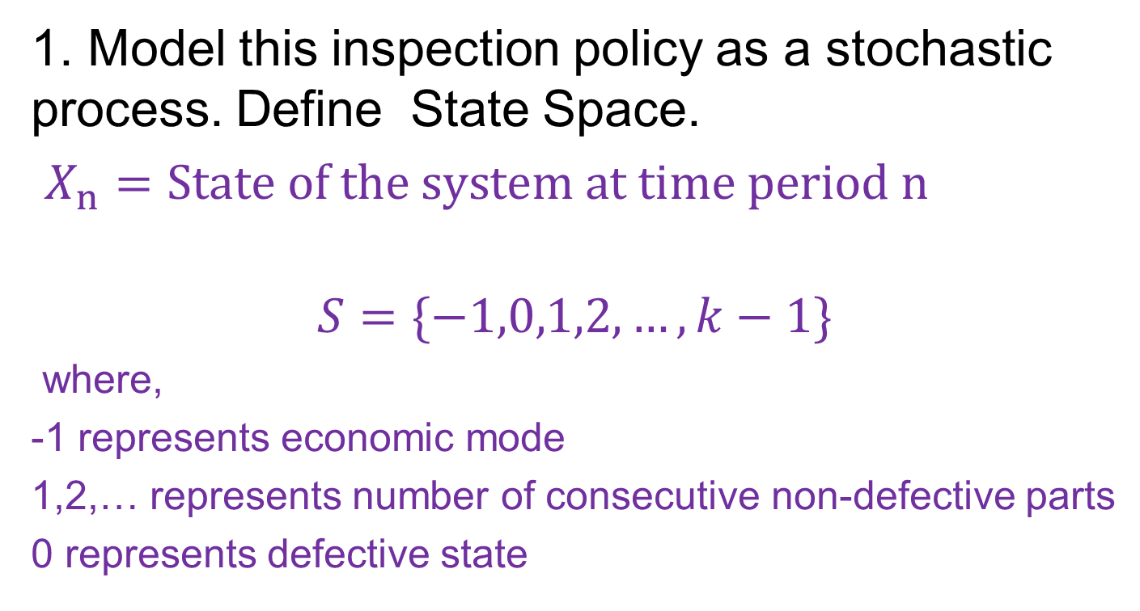
Discussion
1. Model this inspection policy as a stochastic process. Define State Space.
$X_{n}=State of the system at time period n$
$$S=\{−1,0,1,2,…,k−1\}$$
where,
-1 represents economic mode
1,2,… represents number of consecutive non-defective parts
0 represents defective state

Slide 8
Discussion
2. Is the stochastic process a DTMC?
Yes
Future state only depends on present state

Slide 9
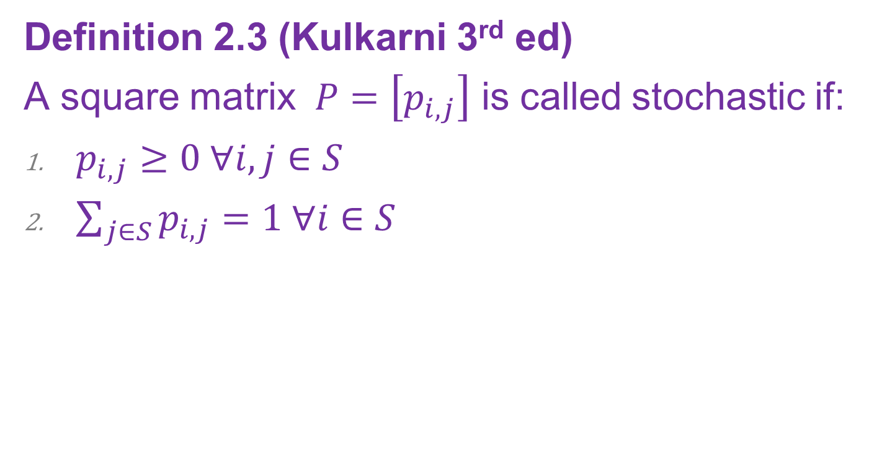
Stochastic Matrix
Definition 2.3 (Kulkarni 3rd ed)
A square matrix $P=\left[p_{i,j}\right]$ is called stochastic if:
$p_{i,j}≥0 ∀i,j∈S$
$\sum_{j∈S}{p_{i,j}}=1 ∀i∈S$

Slide 10

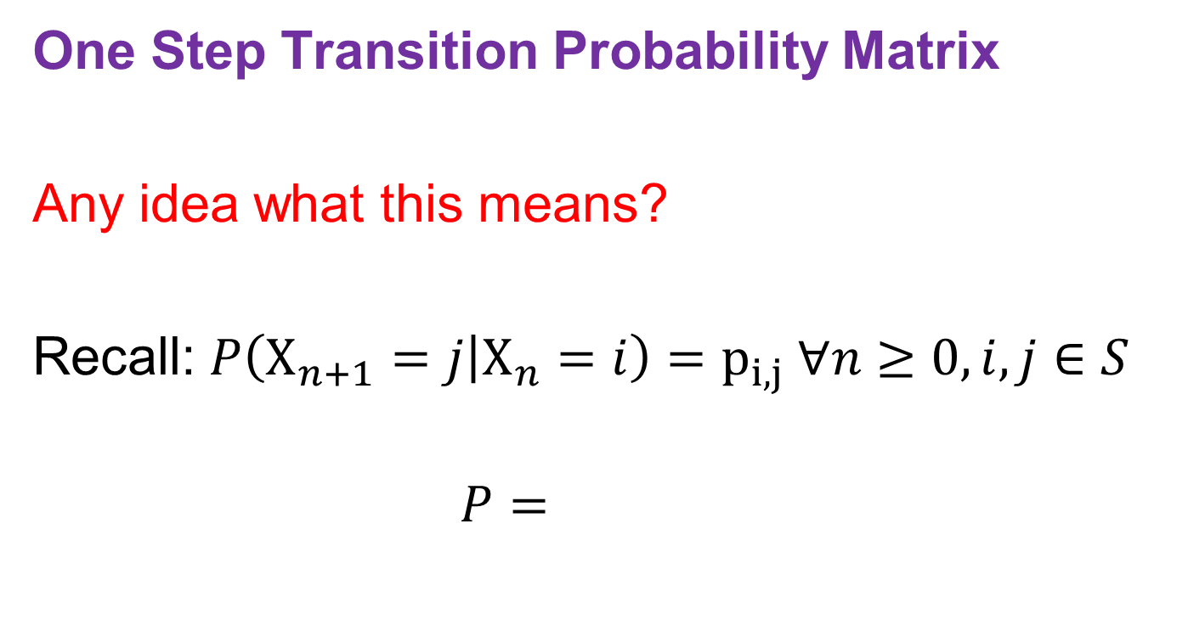

Transition Probability Matrix
One Step Transition Probability Matrix
Any idea what this means?
Recall: $P\left(X_{n+1}=j | X_{n}=i\right)=p_{i,j} ∀n≥0, i,j∈S$
$$P=$$
$p_{1,1} …$ ${ p}_{1,J}$
.
.
.
.
.
.
$p_{J,1} …$ ${ p}_{J,J}$

Slide 11
Properties of Probability Matrix
Theorem 2.1 (Kulkarni 3rd ed)
One Step Transition Probability Matrix is stochastic
Proof:

Slide 12
Example 1 Revisited
A production facility produces one item per hour. Each item is defective with probability p, the quality of successive items being independent. Consider the following quality control policy parameterized by two positive integers k and r. In the beginning the policy calls for 100% inspection, the expensive mode of operation. As soon as k consecutive non-defective items are encountered, it switched to economic mode and calls or inspecting each item with the probability 1/r. It reverts back to the 100% inspection mode as soon as an inspected item is found to be defective. The process alternates this way forever.

Slide 13
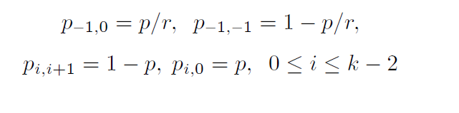


Discussion
3. Define Transition Probability Matrix
State Space, $S=\{−1,0,1,2,…,k−1\}$

Slide 14
Transition Diagram
For the previous example draw the transition diagram?
Lets say k=3 and r=2

Slide 15

Example 2
Consider an example with 2 computers. Comuter repair process has 3 states
0 (No computers have failed)
1 (One computer failed)
2 (Both computers failed)
Transition Matrix is given by:
0.6 0.3 0.1
0.8 0.2 0
1 0 0
$$P=$$

Slide 16
Example 2 – Question 1
Draw the state diagram?

Slide 17
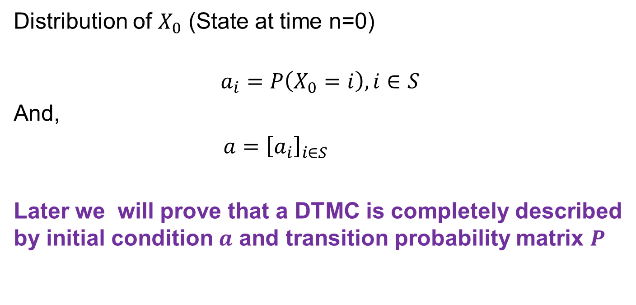
Initial Condition
Distribution of $X_{0}$ (State at time n=0)
$$a_{i}=P\left(X_{0}=i\right), i∈S$$
And,
$a={\left[a_{i}\right]}_{i∈S}$
Later we will prove that a DTMC is completely described by initial condition $a$ and transition probability matrix $P$

Slide 18

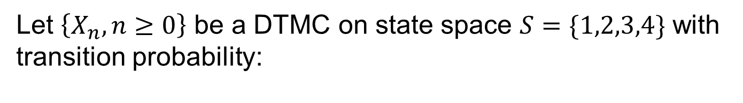
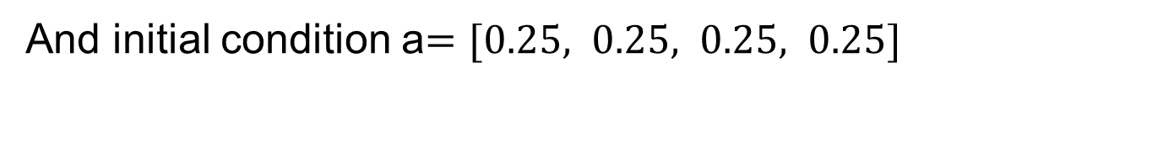
Example 3
Let $\left\{X_{n},n≥0\right\}$ be a DTMC on state space $S=\{1,2,3,4\}$ with transition probability:
0.1 0.2 0.3 0.4
0.2 0.2 0.3 0.3
0.5 0.0 0.5 0.0
0.6 0.2 0.1 0.1
$$P=$$
And initial condition a$=[0.25, 0.25, 0.25, 0.25]$

Slide 19
Example 3 – Question 1
Compute $P(X_{3}=4, X_{2}=1, X_{1}=3, X_{0}=1$)

Slide 20
Example 3 – Question 2
Compute $P(X_{3}=4, X_{2}=1, X_{1}=3$)

